Slide 1

MEMORY PROTECTION TECHNIQUES Vitaly Shmatikov

Slide 2

StackGuard
Embed “canaries” (stack cookies) in stack frames and verify their integrity prior to returning from the function
Any overflow of local variables must damage the canary
buf
canary
sfp
ret
addr
Frame of the
calling function
Top of
stack
Local variables
Pointer to
previous
frame
Return
execution to
this address
Choose random value on program start
(attacker can’t guess what this value will be)
terminator canary: “\0”, newline, linefeed, EOF
or
because strcpy, etc. won’t copy beyond “\0”

Slide 3
StackGuard / Canary Implementation
StackGuard requires code recompilation
Checking canary integrity prior to every function return causes a performance penalty
For example, 8% for Apache Web server
StackGuard can be defeated
A single memory copy where the attacker controls both the source and the destination is sufficient
Or the attacker can infer the value of the canary

Slide 4
Stack Canaries in gcc
local vars
canary
main EBP
main EIP + 5
argv[1]
main local vars
…
Low memory
addresses
High memory
addresses
Flag | Default? | Notes
-fno-stack-protector | No | Turns off protections
-fstack-protector | Yes | Adds to funcs that call alloca() & w/ arrays larger than 8 chars (--param=ssp-buffer-size changes 8)
-fstack-protector-strong | No | Also funcs w/ any arrays & refs to local frame addresses
-fstack-protector-all | No | All funcs

Slide 5
Defeating StackGuard
Suppose the program contains *dst=buf[0] where the attacker controls both dst and buf
buf
dst
canary
sfp
RET
Return execution to
this address
BadPointer, attack code
&RET
canary
sfp
RET
Overwrite the destination of memory copy with the address of saved EIP on the stack

Slide 6
“Reading” the Stack for the Canary Value
A common design for crash recovery:
When process crashes, restart automatically (for availability)
If relaunched using fork, canary is unchanged
Attacker can now
extract the canary
byte by byte
⋯
local buffer
A
C A N A R Y
ret addr
crash
⋯
B
C A N A R Y
ret addr
local
buffer
crash
⋯
C
C A N A R Y
ret addr
local buffer
No crash
⋯
local buffer
C A
C A N A R Y
ret addr
No crash

Slide 7
StackShield
local vars
main EBP
main EIP + 5
argv[1]
main local vars
High memory
addresses
Low memory
addresses
…
Make a copy
StackShield:
Function call: copy return address to safer location (beginning of .data)
Function exit: check if stack value is different on function exit
Circumvention:
Overwrite both the return address & saved copy, if possible
Hijack control flow without overwriting the return address

Slide 8
ProPolice / SSP: Safer Stack Layout
IBM, used in gcc 3.4.1; also MS compilers
args
No arrays or pointers
String growth
return address
exception handler ptrs
SFP
CANARY
Cannot overwrite any pointers
by overflowing an array
arrays
Stack growth
local variables
Ptrs, but no arrays

Slide 9
What Can Still Be Overwritten?
Other string buffers in the vulnerable function
Exception handling records (stored on the stack!)
Pointers to virtual method tables
C++: call to a member function passes as an argument “this” pointer to an object on the stack
Stack overflow can overwrite this object’s vtable pointer and make it point into an attacker-controlled memory
When a virtual function is called (how?), control is transferred to attack code (why?)
Do canaries help in this case?
Hint: when is the integrity of the canary checked?

Slide 10
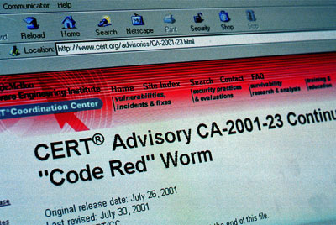





Code Red Worm (2001)
Overwritten to point to a CALL EBX instruction inside the stack-guard routine
exception handler
…
…
CALL EBX
…
CANARY
stack smashed
buffer
stack guard routine notices, calls the exception handler
Finds the worm’s main body and executes it
URL decoding routine in Microsoft Web server
EBX register
Worm’s main body on the heap

Slide 11
Safe Exception Handling
Exception handler record must be on the stack of the current thread
Must point outside the stack (why?)
Must point to a valid handler
Microsoft’s /SafeSEH linker option: header of the binary lists all valid handlers
Exception handler records must form a linked list, terminating in FinalExceptionHandler
Windows Server 2008: SEH chain validation
Address of FinalExceptionHandler is randomized (why?)

Slide 12
SEHOP
SEHOP: Structured Exception Handling Overwrite Protection (since Win Vista SP1)
Observation: SEH attacks typically corrupt the “next” entry in SEH list
SEHOP adds a dummy record at top of SEH list
When exception occurs, dispatcher walks up list and verifies dummy record is there; if not, terminates process
Notes:
SAFESEH: safe structured exception handling
SEHOP: structured exception handling overwrite protection. Enabled with a regkey DisableExceptionChainValidation.

Slide 13
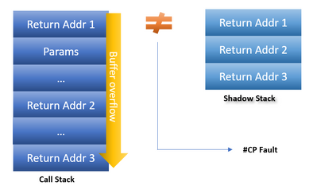
Shadow Stack
On every CALL instruction, return addresses are pushed onto both the call stack and shadow stack
On RET instructions, a comparison is made. If addresses don’t match, CPU raises an exception that traps into the kernel.
On chipsets with Intel’s Control-Flow Enforcement Technology (CET) instructions
https://techcommunity.microsoft.com/t5/windows-kernel-internals/understanding-hardware-enforced-stack-protection/ba-p/1247815

Slide 14
Non-Control Targets
Configuration parameters
Example: directory names that confine remotely invoked programs to a portion of the file system
Pointers to names of system programs
Example: replace the name of a harmless script with an interactive shell
This is not the same as return-to-libc (why?)
Branch conditions in input validation code
None of these exploits violate the integrity of the program’s control flow
Only the original program code is executed!
Chen et al. “Non-Control-Data Attacks Are Realistic Threats”

Slide 15
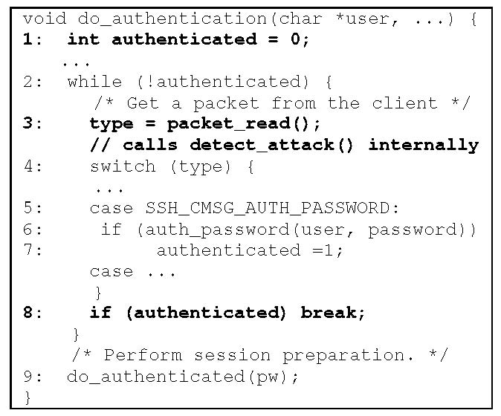
SSH Authentication Code
write 1 here
Loop until one of
the authentication
methods succeeds
detect_attack() prevents
checksum attack on SSH1…
…and also contains an
overflow bug which permits
the attacker to put any value
into any memory location
Break out of the authentication loop without authenticating properly
Chen et al. “Non-Control-Data Attacks Are Realistic Threats”

Slide 16
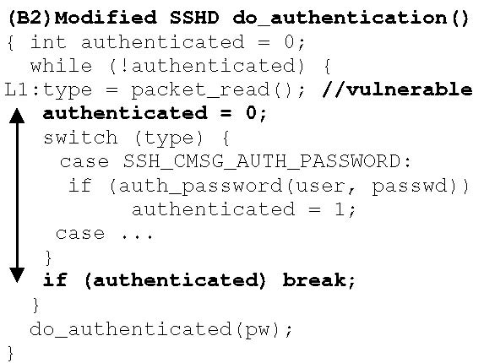
Reducing Lifetime of Critical Data
Reset flag here, right before
doing the checks

Slide 17
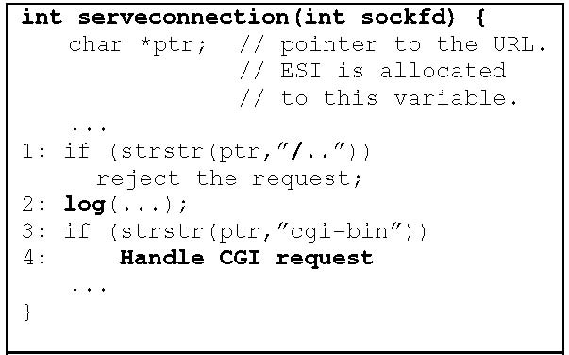
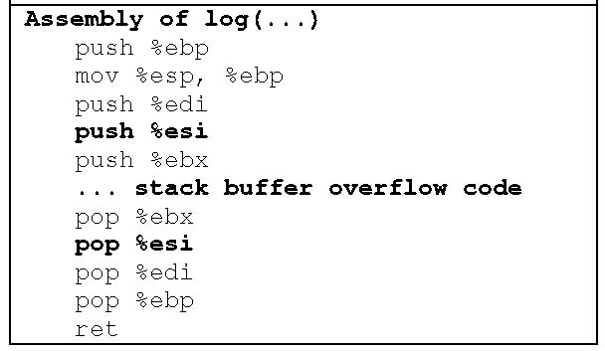
GHTTPD Web Server
ptr changes after it was checked
but before it was used!
(Time-Of-Check-To-Time-Of-Use attack)
Check that URL doesn’t contain “/..”
Register containing pointer to URL
is pushed onto stack…
… overflown
At this point, overflown ptr may point
to a string containing “/..”
… and read from stack
Chen et al. “Non-Control-Data Attacks Are Realistic Threats”

Slide 18
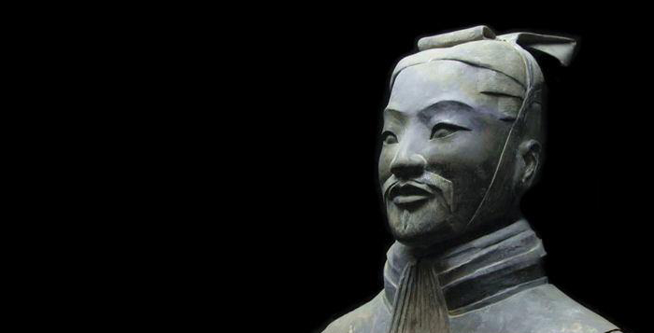
Predictability is a fatal flaw in any defensive system

Slide 19
Problem: Lack of Diversity
Classic memory exploits need to know the (virtual) address to hijack control
Address of attack code in the buffer
Address of a standard kernel library routine
Same address is used on many machines
Slammer infected 75,000 MS-SQL servers in 10 minutes using identical code on every machine
Idea: introduce artificial diversity
Make stack addresses, addresses of library routines, etc. unpredictable and different from machine to machine

Slide 20
ASLR
Address Space Layout Randomization
Randomly choose the base address of stack, heap, code segment, the location of the Global Offset Table
Randomization can be done at compile- or link-time, or by rewriting existing binaries
Randomly pad stack frames and malloc’ed areas
Other randomization methods: randomize system call ids or even instruction set

Slide 21
Base-Address Randomization
Only the base address is randomized
Layouts of stack and library table remain the same
Relative distances between memory objects are not changed by base address randomization
To attack, enough to guess the base shift
A 16-bit value can be guessed by brute force
Try 2¹⁵ (on average) overflows with different values for the address of a known library function – how long does it take?
If guess is wrong, target will simply crash & restart
usleep() is a good candidate (why?)

Slide 22
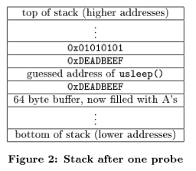

Brute-Force Guessing
request
Web server with a buffer overflow
Attacker makes a
guess of where usleep()
is located in memory
Failure crashes the child process immediately and therefore kills connection
Success crashes the child process after sleeping for 0x01010101 microseconds and kills connection
Unlikely to work on a 64-bit architecture

Slide 23
ASLR in Windows (since 2008)
Stack randomization
Find N^{th} hole of suitable size (N is a 5-bit random value), then random word-aligned offset (9 bits of randomness)
Heap randomization: 5 bits
Linear search for base + random 64K-aligned offset
EXE randomization: 8 bits
Preferred base + random 64K-aligned offset
DLL randomization: 8 bits
Random offset in DLL area; random loading order

Slide 24
Defeating ASLR by Reading the Stack
Request (can trigger buffer overflow in stack)
Apache forks
off child process
to handle request
Response (unless process crashes)
local var1
random
canary
EBP
EIP
Param1
caller local vars
…
junk
x
y
z
w
x
y
z
w
Reading the stack for EBP/EIP can give approximate address offset

Slide 25
ASLR Against Heap Attacks
<SCRIPT language="text/javascript">
shellcode = unescape("%u4343%u4343%...");
overflow-string = unescape(“%u2332%u4276%...”);
cause-overflow( overflow-string ); // overflow buf[ ]
</SCRIPT>
shell code
Where will the browser place
the shellcode on the heap???
object
buf[256]
vtable
ptr
data

Slide 26
Heap Spraying
JIT is a great target: it creates code on the fly, thus its memory must be writeable, readable, executable
Force JavaScript JiT (“just-in-time” compiler) to fill heap with executable shellcode, then point SFP or vtable ptr anywhere in the spray area
NOP slide
shellcode
execute enabled
execute enabled
heap
execute enabled
execute enabled
execute enabled
execute enabled

Slide 27
JavaScript Heap Spraying
var nop = unescape(“%u9090%u9090”)
while (nop.length < 0x100000) nop += nop
var shellcode = unescape("%u4343%u4343%...");
var x = new Array ()
for (i=0; i<1000; i++) {
x[i] = nop + shellcode;
}
Pointing a function pointer anywhere in the heap will cause shellcode to execute

Slide 28


Heap Feng Shui (aka Heap Grooming)
Achieve the desired heap layout by a sequence of crafted memory allocations and deallocations
free blocks
Safari PCRE exploit (2008): placing the vulnerable object next to attacker-controlled memory
heap
object O

Slide 29
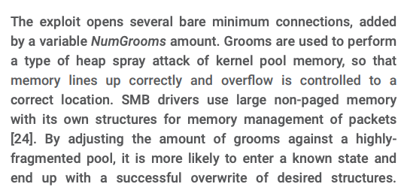
Heap Spraying in EternalBlue
https://risksense.com/wp-content/uploads/2018/05/White-Paper_Eternal-Blue.pdf

Slide 30

Memory Attacks: Causes and Cures
“Classic” memory exploit involves code injection
Put malicious code at a predictable location in memory, usually masquerading as data
Trick vulnerable program into passing control to it
Overwrite saved EIP, function callback pointer, etc.
Idea: prevent execution of untrusted code
Make stack and other data areas non-executable
Digitally sign all code
Ensure that all control transfers are into a trusted, approved code image

Slide 31
W⊕X / DEP
Mark all writeable memory locations as non-executable
Example: Microsoft’s DEP - Data Execution Prevention
This blocks most (not all) code injection exploits
Hardware support
AMD “NX” bit, IA-64 “XD” bit, ARMv6 “XN” bit
OS can make a memory page non-executable
Widely deployed
Windows (since XP SP2), Linux (via PaX patches), OpenBSD, OS X (since 10.5)

Slide 32
Issues with W⊕X / DEP
Some applications require executable stack
Example: JavaScript, Flash, Lisp, other interpreters
GCC stack trampolines (calling conventions, nested functions)
JVM makes all its memory RWX – readable, writable, executable (why?)
Some applications (eg, browsers) don’t use DEP
Attack can start by “returning” into a memory mapping routine and make the page containing attack code writeable

Slide 33

What Does W⊕X Not Prevent?
Can still corrupt stack!
… or function pointers or critical data on the heap, but that’s not important right now
As long as “saved EIP” points into existing code, W⊕X protection will not block control transfer
This is the basis of return-to-libc exploits: overwrite saved EIP with the address of any library routine, arrange memory to look like arguments
Does not look like a huge threat, since attacker cannot execute arbitrary code, especially if system() is not available

Slide 34

return-to-libc on Steroids
Overwritten saved EIP need not point to the beginning of a library routine. Any existing instruction in the code image is fine… processor will execute the sequence starting from that instruction
What if the instruction sequence contains RET?
Execution will be transferred to… where?
Read the word pointed to by stack pointer (ESP)
Guess what? Its value is under attacker’s control! (why?)
Use it as the new value for EIP… now control is transferred to an address of attacker’s choice!
Increment ESP to point to the next word on the stack

Slide 35


Chaining RETs for Fun and Profit
Can chain together sequences ending in RET
Krahmer, “x86-64 buffer overflow exploits and the borrowed code chunks exploitation technique” (2005)
What is this good for? Everything!
Turing-complete language
Build “gadgets” for load-store, arithmetic, logic, control flow, system calls
Attack can perform arbitrary computation using no injected code at all!
Hovav Shacham

Slide 36
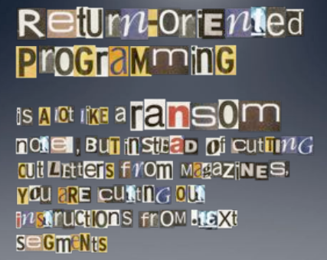
Image by Dino Dai Zovi

Slide 37
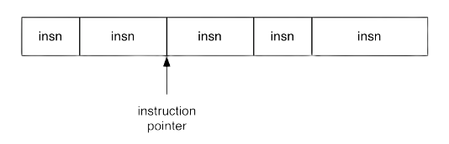
Ordinary Programming
Instruction pointer (EIP) determines which instruction to fetch and execute
Once processor has executed the instruction, it automatically increments EIP to next instruction
Control flow by changing the value of EIP

Slide 38
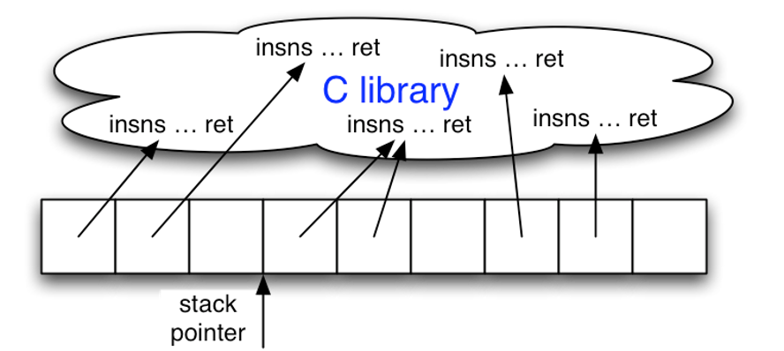
Return-Oriented Programming
Key idea: build arbitrary computations from existing code sequences ending in RET
Stack pointer (ESP) determines which instruction sequence to fetch and execute
Processor doesn’t automatically increment ESP … but RET at end of each instruction sequence does

Slide 39
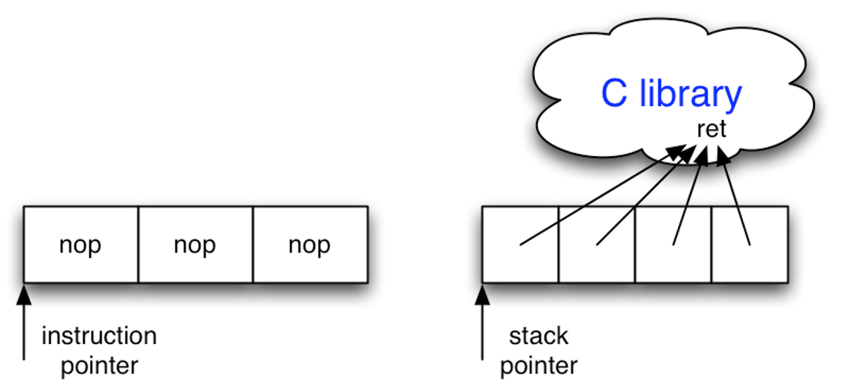
No-Ops (Useful for No-Op Sleds)
No-op instruction does nothing but advance EIP
Return-oriented equivalent:
pointer to RET instruction
(advances ESP)

Slide 40
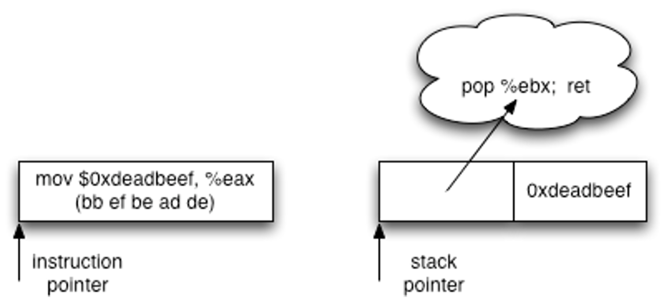
Immediate Constants
Instructions can encode constants
Return-oriented equivalent:
Store value on the stack
Pop into register to use

Slide 41
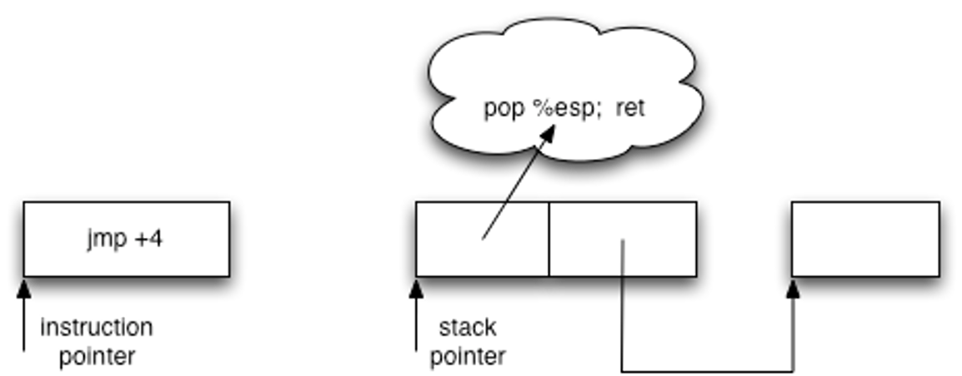
Control Flow
(Conditionally) set EIP to a new value
Return-oriented equivalent:
(Conditionally) set ESP to a new value

Slide 42
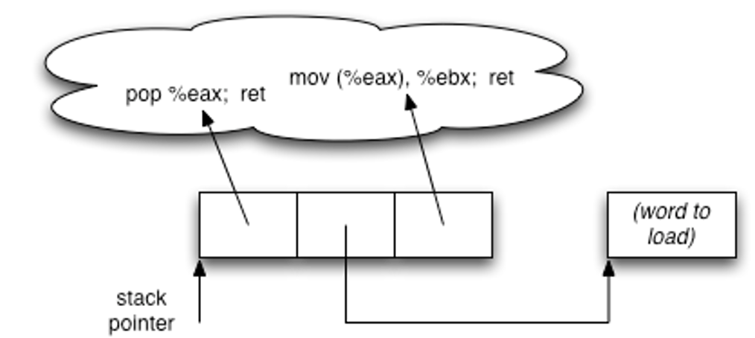
Gadgets: Multi-Instruction Sequences
Sometimes more than one instruction sequence needed to encode logical unit
Example: load from memory into register
Load address of source word into EAX
Load memory at (EAX) into EBX

Slide 43
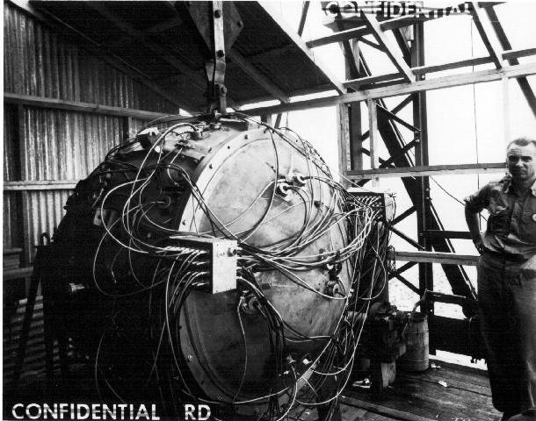
“The Gadget” (July 1945)
ROP gadgets
Gadgets built from found code sequences: load-store, arithmetic & logic, control flow, syscalls
Found code sequences are challenging to use!
Short; perform a small unit of work
No standard function prologue/epilogue
Haphazard interface, not an ABI
Some convenient instructions not always available

Slide 44
Conditional Jumps
Conventional programming
Return-oriented programming
cmp compares operands and sets several flags in the EFLAGS register
Luckily, many other ops set EFLAGS as a side effect
jcc jumps when flags satisfy certain conditions
But this causes a change in EIP… not useful (why?)
Need conditional change in stack pointer (ESP)
Strategy:
Move flags to a general-purpose register
Compute either delta (if flag is 1) or 0 (if flag is 0)
Perturb ESP by the computed delta

Slide 45
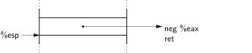
Phase 1: Perform Comparison
neg calculates two’s complement
As a side effect, sets carry flag (CF) if the argument is nonzero
Use this to test for equality
sub is similar, use to test if one number is greater than another

Slide 46
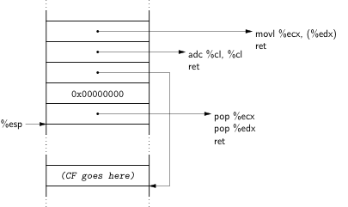
Phase 2: Store 1-or-0 to Memory
❹
❸
❶
❷
❶ Clear ECX
❷ EDX points to destination
❸ adc adds up its operands & the carry flag;
result will be equal to the carry flag (why?)
❹ Store result of adc (carry flag) into destination

Slide 47
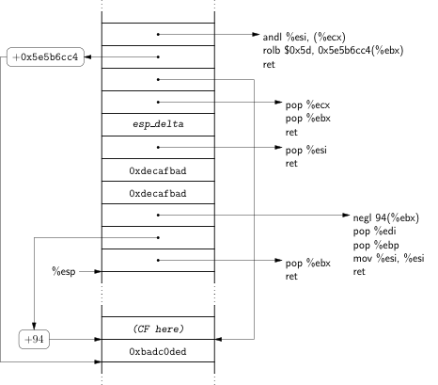
Phase 3: Compute Delta-or-Zero
Bitwise AND with delta
(in ESI)
Two’s-complement negation:
0 becomes 0…0;
1 becomes 1…1

Slide 48
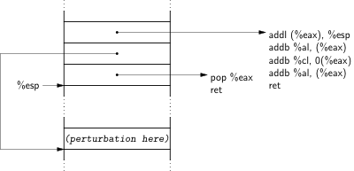
Phase 4: Perturb ESP by Delta

Slide 49
Finding Instruction Sequences
Any instruction sequence ending in RET is useful
Algorithmic problem: recover all sequences of valid instructions from libc that end in a RET
At each RET instruction (C3 byte), look back:
Are the preceding i bytes a valid instruction?
Recur from found instructions
Collect found instruction sequences in a trie

Slide 50
Unintended Instructions
Actual code from ecb_crypt()
c7
45
d4
01
00
00
00
f7
c7
07
00
00
00
0f
95
45
c3
movl $0x00000001, -44(%ebp)
add %dh, %bh
movl $0x0F000000, (%edi)
test $0x00000007, %edi
On x86, can jump into the middle of an instruction. If the following bytes are valid opcodes, processor will execute!
}
xchg %ebp, %eax
}
inc %ebp
}
ret
setnzb -61(%ebp)

Slide 51
The Joy of x86
Register-memory machine
Plentiful opportunities for accessing memory
Register-starved
Multiple sequences likely to operate on same register
Instructions are variable-length, unaligned
More instruction sequences exist in libc
Instruction types not issued by compiler may be available
Unstructured call/ret ABI
Any sequence ending in a return is useful

Slide 52
SPARC: The Un-x86
ROP on SPARC
Load-store RISC machine
Only a few special instructions access memory
Register-rich
128 registers; 32 available to any given function
All instructions 32 bits long; alignment enforced
No unintended instructions
Highly structured calling convention
Register windows
Stack frames have specific format
Use instruction sequences that are suffixes of real functions
Dataflow within a gadget
Structured dataflow to dovetail with calling convention
Dataflow between gadgets
Each gadget is memory-memory
Turing-complete computation!

Slide 53
kBouncer
winner of the 2012 Microsoft BlueHat Prize ($200K)
pop rdi
ret
pop rsi
ret
pop rax
ret
syscall
ret
kernel
kBouncer
Observation: abnormal execution sequence violates LIFO call-return order
Defense: before a system call, check that every prior ret is not abnormal
ret returns to an address that does not follow a call

Slide 54
kBouncer
winner of the 2012 Microsoft BlueHat Prize ($200K)
pop rdi
ret
pop rsi
ret
pop rax
ret
syscall
ret
kernel
kBouncer
Intel’s Last Branch Recording (LBR):
Stores 16 last executed branches in a set of on-chip registers (MSR)
Can read using rdmsr instruction from privileged mode
kBouncer: before entering kernel, verify that last 16 ret’s are normal
Requires no application code changes, minimal overhead
Limitations: attacker can ensure 16 calls prior to syscall are valid

Slide 55
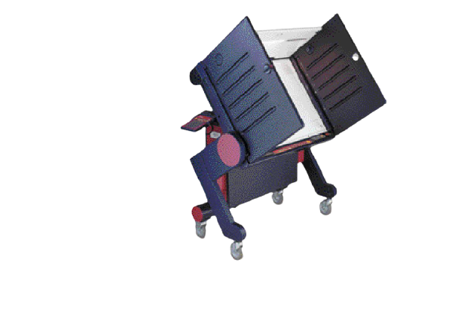
Defeating Other ROP Defenses
“Return-oriented programming without returns” (2010)
“Jump-oriented” programming
Use update-load-branch sequences instead of returns + a trampoline sequence to chain them together
Craft a separate function call stack and call legitimate functions present in the program
Checkoway et al.’s attack on the Sequoia AVC Advantage voting machine
Harvard architecture: code is separate from data, thus code injection is impossible.
ROP works fine!

Slide 56
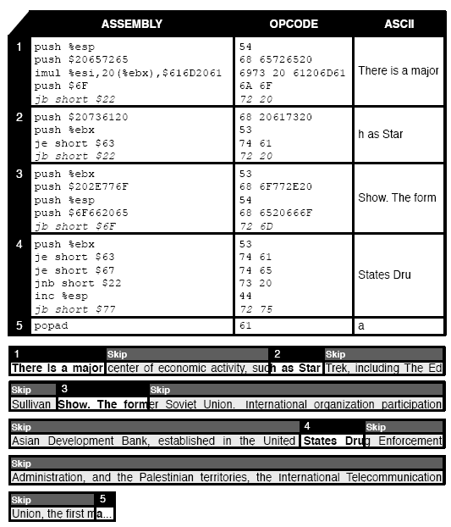
English Shellcode
Convert any shellcode into an English-looking text
Encoded payload, decoder uses only a subset of x86 instructions (those whose binary representation corresponds to English ASCII characters)
Example: popa – “a”, push %eax – “p”
Additional processing and padding
Mason et al. (2009)

Slide 57
CFI: Control-Flow Integrity
Main idea: self-protecting code
Pre-determine control flow graph (CFG) of an application
Static analysis of source code
Static binary analysis ← CFI
Execution profiling
Explicit specification of security policy
Insert checks to ensure that execution follows the pre-determined control flow graph
Abadi et al. “Control-Flow Integrity” (2005)

Slide 58
CFI via Binary Instrumentation
Use binary rewriting to instrument code with runtime checks
Inserted checks ensure that whenever an instruction transfers control, destination is valid according to the CFG
Therefore, the execution always stays within the statically determined CFG
Goal: prevent injection of arbitrary code and invalid control transfers (e.g., return-to-libc) even if the attacker has complete control over the thread’s address space

Slide 59
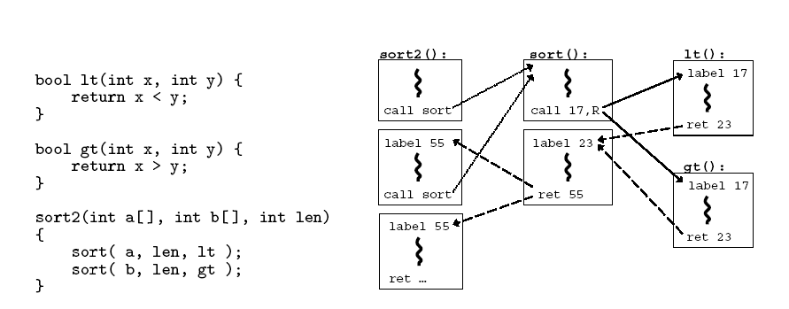


CFG Example
This CFG permits more executions than are actually possible (why?)

Slide 60

Control Flow Enforcement in CFI
For each control transfer, determine statically its possible destination(s)
Insert a unique bit pattern at every destination
Two destinations are equivalent if static CFG contains edges to each from the same source
Use same bit pattern for equivalent destinations
Insert binary code that at runtime will check whether the bit pattern of the target instruction matches the pattern of possible destinations
This is imprecise (why?)

Slide 61
CFI: Example of Instrumentation
Original code
Instrumented code
Abuse an x86 assembly instruction to
insert “12345678” tag into the binary
Jump to the destination only if
the tag is equal to “12345678”

Slide 62
Preventing Circumvention
What about run-time code generation and self-modification?
Unique IDs
Bit patterns chosen as destination IDs must not appear anywhere else in the code memory except ID checks
Non-writable code
Program should not modify code memory at runtime
Non-executable data
Program should not execute data as if it were code
Enforcement: hardware support + prohibit system calls that change protection state + verification at load-time

Slide 63
Improving CFI Precision
Suppose a call from A goes to C, and a call from B goes to either C, or D (when can this happen?)
CFI will use the same tag for C and D, but this permits an invalid call from A to D
Possible solutions: (1) duplicate code or inline; (2) multiple tags
Function F is called first from A, then from B. What’s a valid destination for its return?
CFI will use the same tag for both call sites, but this allows F to return to B after being called from A
Solution: shadow call stack

Slide 64
CFI Security Guarantees
Effective against attacks based on illegitimate control-flow transfer
Stack-based buffer overflow, return-to-libc exploits, function pointer overwrite
Does not protect against attacks that do not violate the program’s original CFG
Incorrect arguments to system calls
Substitution of file names
Other data-only attacks

Slide 65
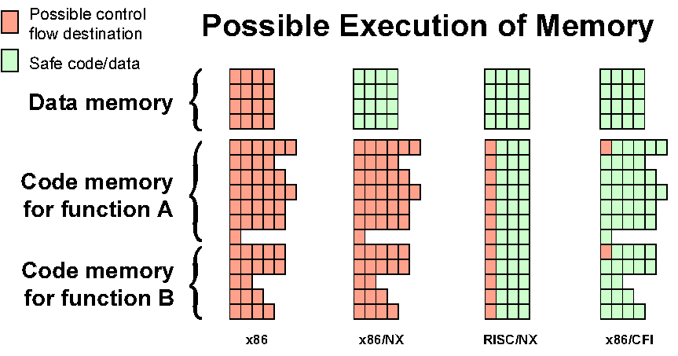
Possible Execution of Memory
Credit: Ulfar Erlingsson

Slide 66
Control-Flow Guard (CFG) in Windows 10
Poor man’s CFI, sort of…
Protects indirect calls by checking against a bitmask of all valid function entry points in the executable
ensures the target is the entry point of a function
Does not prevent attacker from causing a jump to a valid wrong function
Hard to build accurate control flow graph statically

Slide 67
Intel’s CET
Deployed in Intel Tiger Lake (2020)
⦚
call eax
New EndBranch (ENDBR64) instruction
Compiler inserts EndBranch at all valid destinations of control transfers
After an indirect JMP or CALL, the next instruction in the instruction stream must be EndBranch
If not, then trigger a #CP fault and halt execution
⦚
endbranch
add ebp, 4
⦚
⦚
Does not prevent attacker from causing a jump to a valid wrong function
Hard to build accurate control flow graph statically

Slide 68
Bypassing CFG and CET
void HandshakeHandler(Session *s, char *pkt) {
s->hdlr = &LoginHandler;
... Buffer overflow over Session struct ...
}
void LoginHandler(Session *s, char *pkt) {
bool auth = CheckCredentials(pkt);
s->dhandler = &DataHandler;
}
void DataHandler(Session *s, char *pkt);
Attacker controls handler
static control-flow graph permits attacker to call DataHandler to bypass authentication

Slide 69
Cryptographic CFI (CCFI)
also ARM pointer authentication
Every time a jump address is written/copied anywhere in memory, compute 64-bit AES-MAC and append to address
On heap: tag = AES(k, (jump-address, 0 ll source-address) )
On stack: tag = AES(k, (jump-address, 1 ll stack-frame) )
Before control transfer, verify AES-MAC and crash if invalid
Where to store key k? In xmm registers (not memory)

